Slide 1


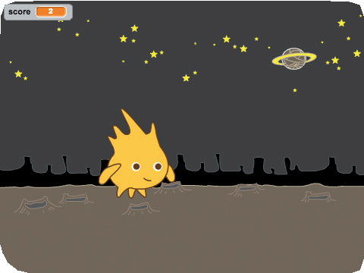
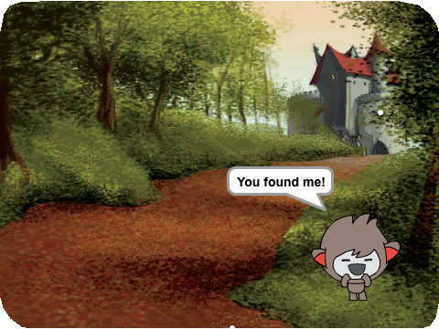
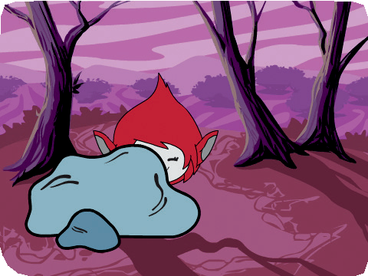
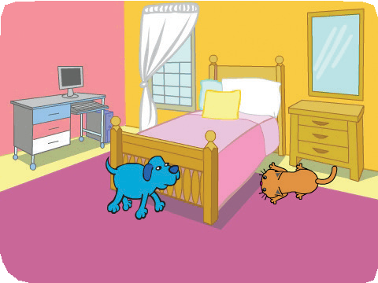

Hide and Seek Cards
Hide and Seek ¹
Make a hide-and-seek game with characters that appear and disappear.
scratch.mit.edu/hide

Slide 2
Hide and Seek Cards
Hide and Seek ²
Use these cards in this order:
Disappear
Click and Say
Surprise Timing
Go Random!
Click for Points
Hiding Place
scratch.mit.edu/hide

Slide 3



Disappear
Make a sprite disappear and appear again.
Hide and Seek
1

Slide 4


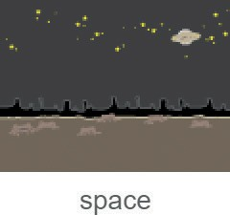


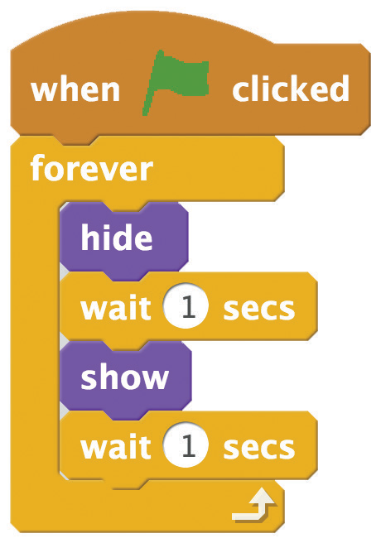


Disappear
scratch.mit.edu/hide
GET READY
Choose a sprite to hide.
Choose a backdrop.
ADD THIS CODE
TRY IT
Click the green flag to start.

Slide 5


Click and Say
Make a sprite speak when you click it.
Hide and Seek
2

Slide 6

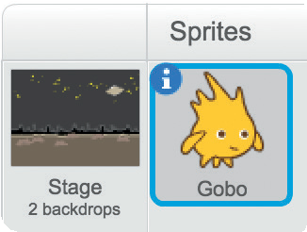


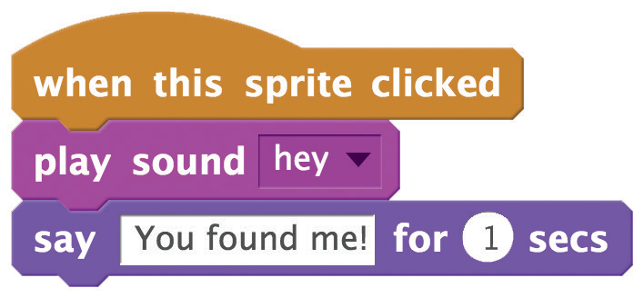

Click and Say
scratch.mit.edu/hide
GET READY
Click to select your sprite.
Click the
tab.
Then choose a sound from the Sound library.
ADD THIS CODE
Click the tab.
Type what you want your sprite to say.
TRY IT
Click your sprite.

Slide 7
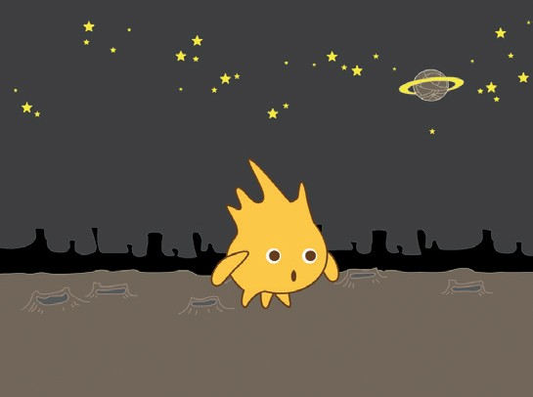
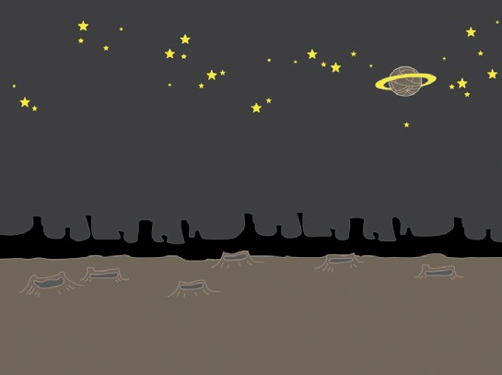

Surprise Timing
Make a sprite wait for a random amount of time before appearing again.
Hide and Seek
3

Slide 8

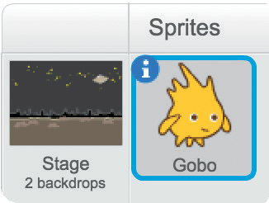
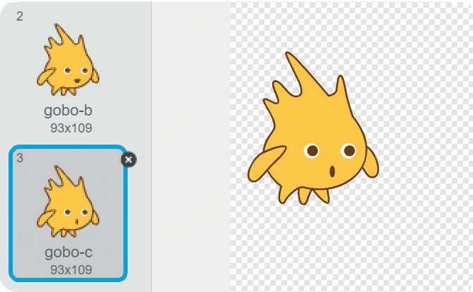
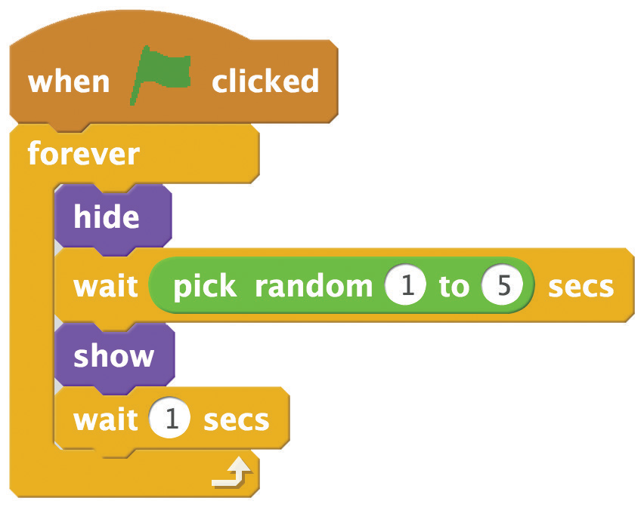

Surprise Timing
scratch.mit.edu/hide
GET READY
Click to select your sprite.
Click the tab and choose the costume you want.
ADD THIS CODE
Click the tab.
Insert the pick random block.
TIP
Play with the timing! Try typing in a different range of numbers.

Slide 9
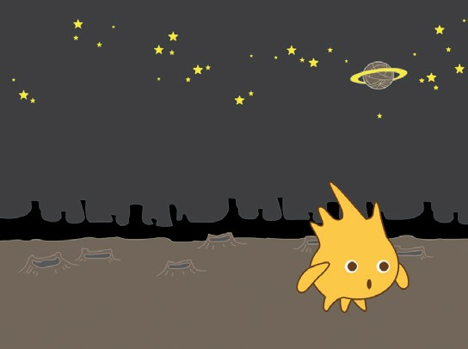
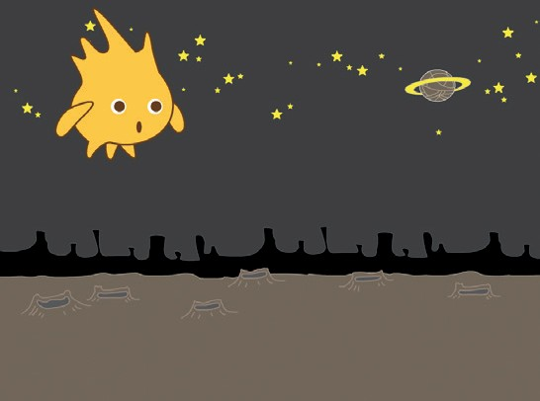
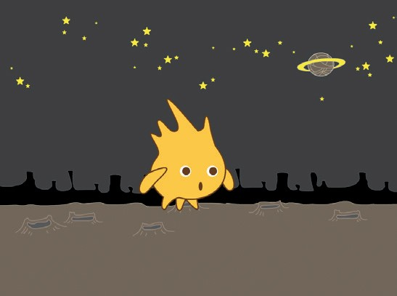
Go Random!
Make a sprite jump to random spots on the Stage.
Hide and Seek
4

Slide 10
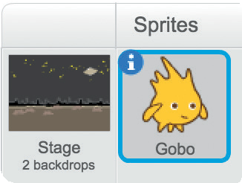
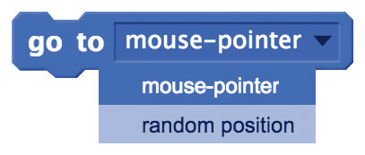
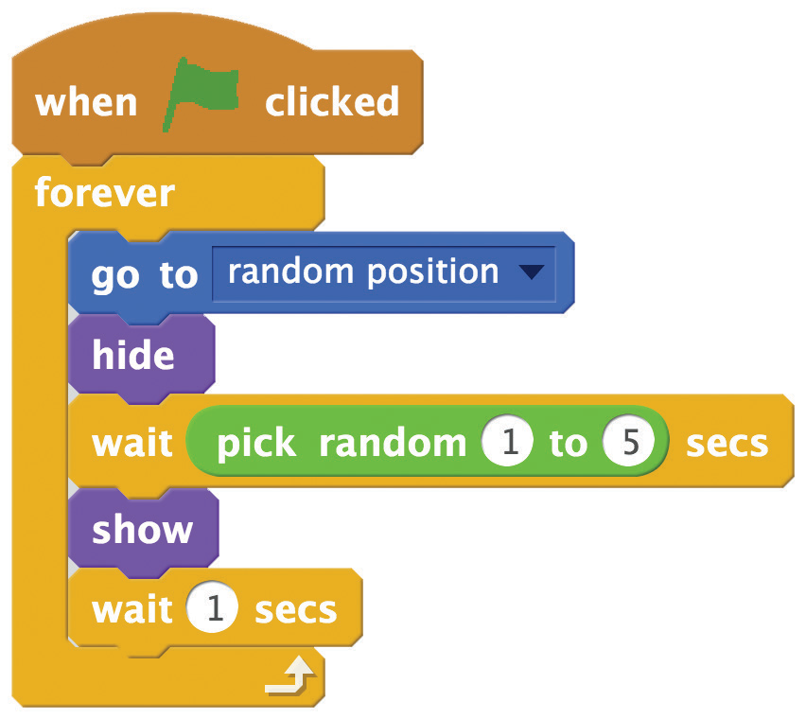

Go Random!
scratch.mit.edu/hide
GET READY
Click to select your sprite.
ADD THIS CODE
Choose random position
from the menu.
TRY IT
Click the green flag to start.

Slide 11
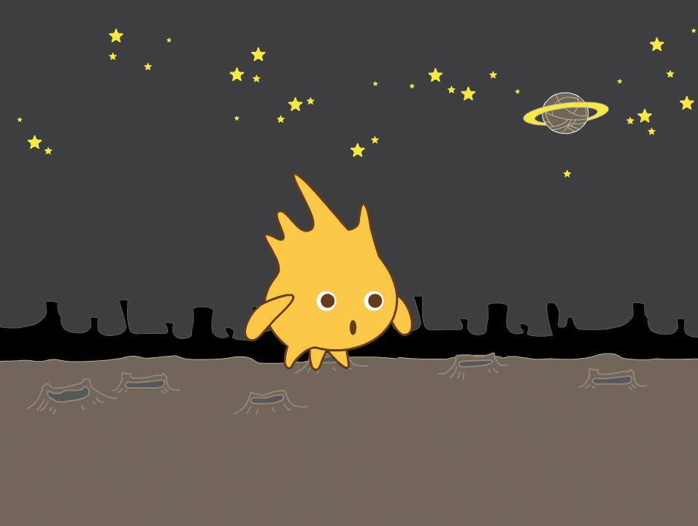

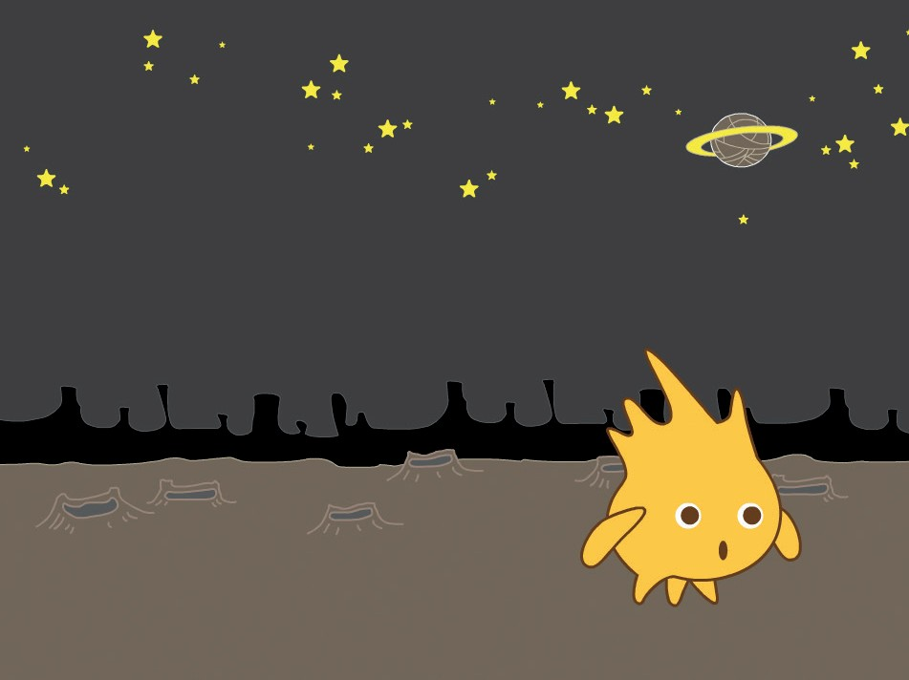

Click for Points
Add a point each time you click a sprite.
Hide and Seek
151

Slide 12
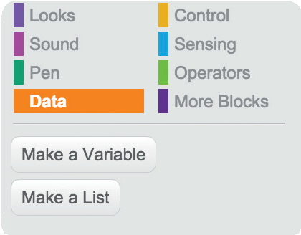
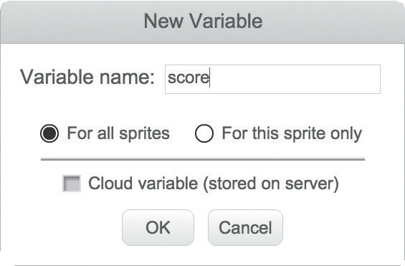
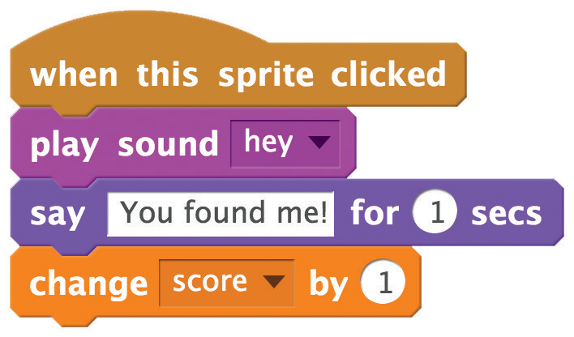

Click for Points
scratch.mit.edu/hide
GET READY
Choose Data.
Click the Make a Variable button.
Name this variable score
and then click OK.
ADD THIS CODE
Add this block.
TIP
Add this script to make the score reset to 0 when you click the green flag.

Slide 13
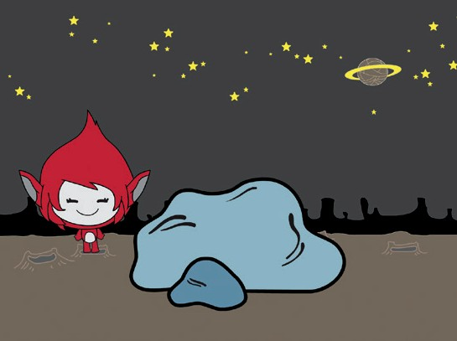
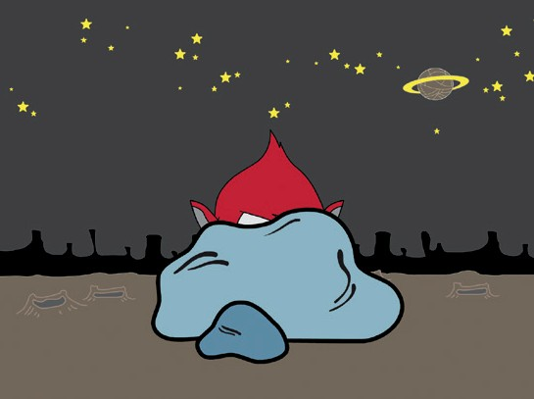
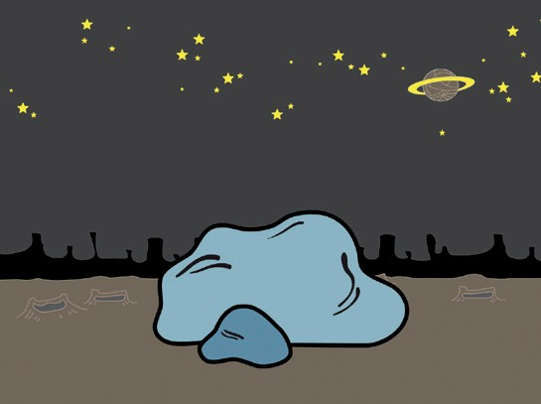
Hiding Place
Make a sprite hide behind something.
Hide and Seek
6

Slide 14



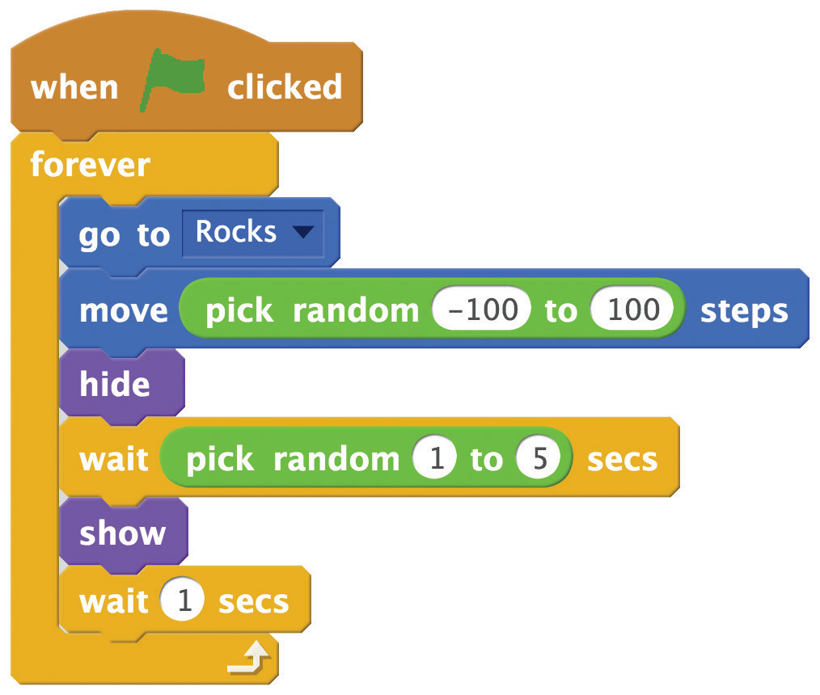



Hiding Place
scratch.mit.edu/hide
GET READY
Choose a sprite to be a hiding place, like Rocks.
Then choose another sprite who will hide.
ADD THIS CODE
Choose the hiding place.
TIP
Click the Grow or Shrink tool and then click the sprite to change its size.
Grow Shrink

